Slide 1
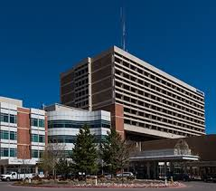
Denver Health Medical Center New Candidates Places to Live Things to Do Near Work

Slide 2
Project Introduction
Goals of the Project:
Project for Denver Health Medical Center
Map of Denver
List of Neighborhoods with lowest crime rates
Maps of the neighborhoods with lowest crime rates
Provide a list of businesses within 1,000 meters of Denver Health

Slide 3
Additional Uses for Data
Hotels
Conference/Convention Centers
Real Estate Companies
Businesses and organizations who recruit candidates from outside of the Denver Area

Slide 4

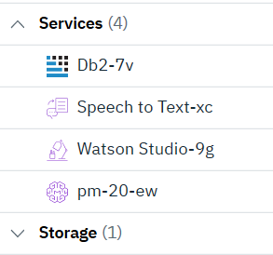


Data Acquisition & Platforms
2019 Denver crime data set
https://www.denvergov.org/opendata/dataset/city-and-county-of-denver-crime
Foursquare.com
API Technology
Platform
IBM Watson Studio via the IBM Cloud

Slide 5
Methodology
Pre-processed csv file to filter out crimes
The csv dataset obtained from the Denver.org website includes data from 2015-2019 and contained 460,032 lines of data with 267 types of criminal offenses.
Applied filter for only 2019
Combined similar offense names
Removed many fields, such as counterfeiting, forgery, and traffic incidents
The remaining criminal offense categories were reduced from 267 to 20.
Uploaded csv file to IBM Watson Studio
Deleted 15 columns to obtain relevant 4 columns and renamed to Crime, Longitude, Latitude, and Neighborhood

Slide 6
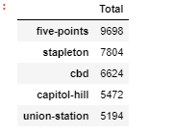
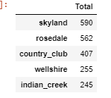
Preprocessing Continued…
Filtered data to obtain the number of crimes per neighborhood
Further filtered to show the top and bottom five neighborhoods with the most and least reported crimes, respectively
Most Crime Least Crime

Slide 7
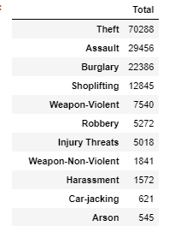
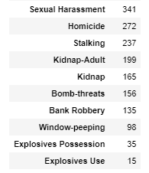
Additional Processing
Filtered Data to obtain the total crime offenses by type and their total:

Slide 8
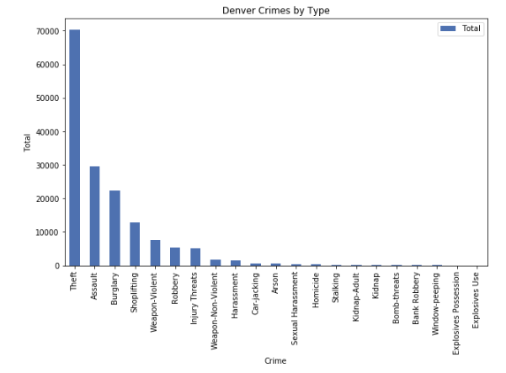
Data Processed:

Slide 9
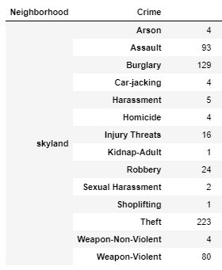
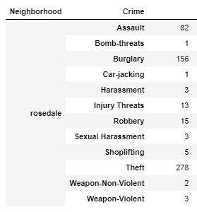

Slide 10
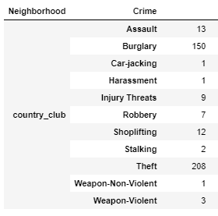
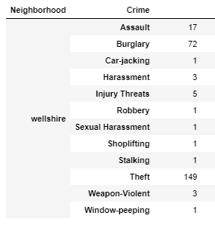
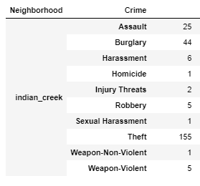

Slide 11
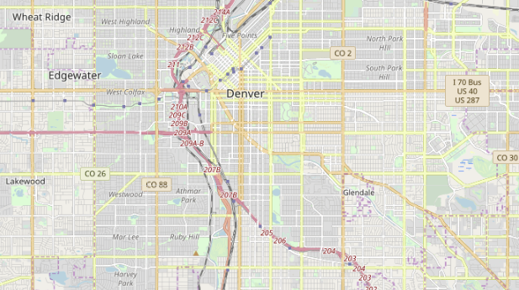
Denver Map: latitude= 39.742043 longitude = -104.991531

Slide 12
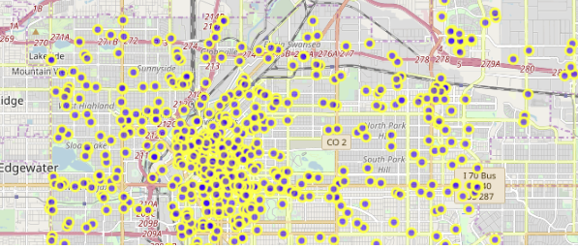
1,000 Random Crimes/Neighborhoods Cluttered Version

Slide 13
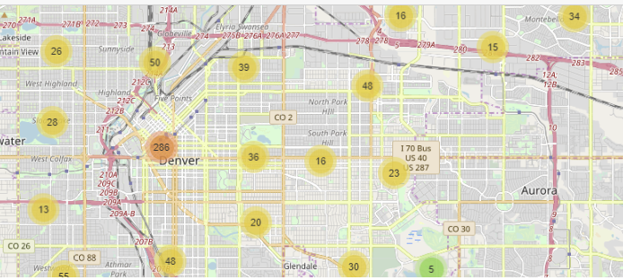
Uncluttered Version:

Slide 14
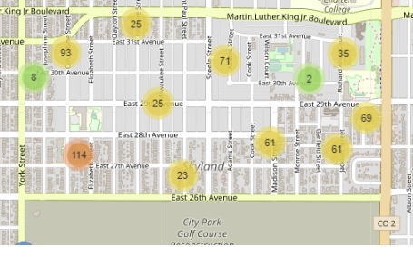
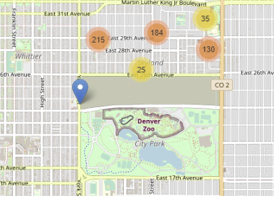
Skyland Neighborhood:
While this neighborhood has a relatively low crime rate, the number of assaults and violent weapon crimes do not make this an ideal recommendation.
When zoomed out a little more, the neighborhood is close to the beautiful Denver Zoo, a golf course, and the city park.

Slide 15
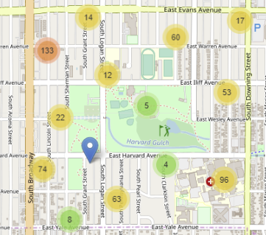
Rosedale Neighborhood
There are fewer violent weapons crimes than Skyland
Roseland surrounds a golf course and park with a recreational facility.

Slide 16
Country-Club Neighborhood
The assaults are significantly at 13 compared with 82 in Rosedale
The Country-Club has a large park with a golf course and Cherry Creek running through the park

Slide 17
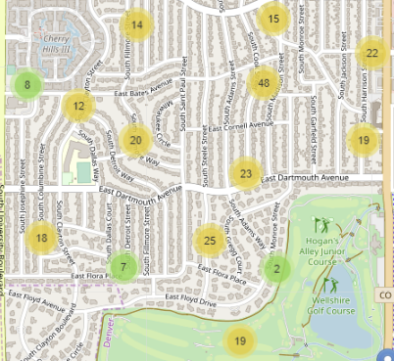
Wellshire Neighborhood
Slightly higher rate of assaults than the Country-Club neighborhood
Two golf courses close by

Slide 18
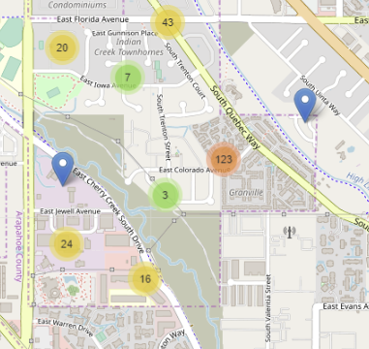
Indian-Creek Neighborhood
The Indian-Creek Neighborhood has the lowest crime rate in Denver with 245 crimes reported
the assault rates are higher in this neighborhood than Wellshire and Country-Club
Close to the Cherry Creek Country Club & Cherry Creek State Park

Slide 19
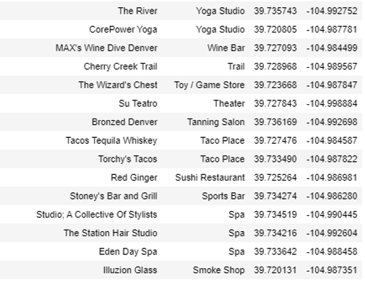
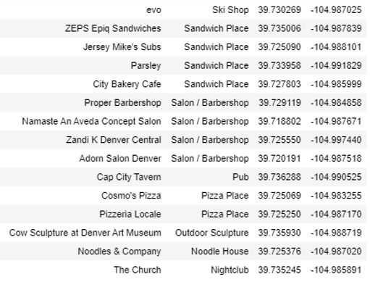
Venues close to Denver Health

Slide 20
Conclusion
The report provides robust crime data for the city of Denver for 2019
The data and mapping provided the answers requested by the Denver Health Medical Center
Recommends five neighborhoods in Denver with the lowest crime rates
Provided a list of the 30 different businesses and parks closest to the Denver Health Medical Center
Geographical coordinates included for easy searching on mobile platforms such as Google Maps
The report is also useful to real estate companies, schools, and other businesses assisting with employee relocation
The Foursquare API data can be easily used by any business by inputting their address

